Slide 1


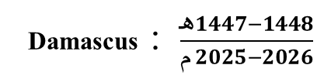
Driving & Vehicle License Department (DVLD)
Students Name :
Hasan Al-homsi
Ahmad Al-asfar
Adnan Al-masalmeh
SUPERVISOR'S NAME:
Dr. Kadan
Eng. Mohammed
Damascus : $\frac{هـ1447−1448}{م 2025−2026}$

Slide 2
Abstract/Introduction
The DVLD System is a comprehensive digital platform developed to modernize and automate driving license services such as issuing, renewing, and replacing lost or damaged licenses. We developed DVLD using C# .net framework windows form & for Desktop and Razor C# html,css,js for wep portal to make the process easy for both citizen and employee.

Slide 3
Problem Statement & Objectives
The proplem :
Manual processing results in overlapping test scheduling, human indexing mistakes, and severe lack of historical transparency for driving licenses and violations.
Project Objectives:
Automating the license application process and reducing human error.
Simplifying the search process and managing user data and applications.
Enhancing the user experience through an interactive and user-friendly interface.

Slide 4
Scope, Constraints & Assumptions
System Scope :
Fully automates vision, written, and practical street exams. Handles domestic and international licensing, replacement of lost or damaged documents, and violation-based license holds.
Key Constraints:
Bound to a 1-semester project schedule. Employs offline SQL Server schemas. Relies on internal government LAN architectures with low-latency requirement bounds.
Operational Assumptions :
Operators possess basic desktop computing literacy. Database replication targets central SQL server nodes nightly. Citizens have standard internet browser clients.

Slide 5
Related Works
Comparison Aspect | RTA Dubai | DMV United States | DVLA United Kingdom | DVLD
Citizen Online Portal | ✓ | ✓ | ✓ | ✓
Mobile Application | ✓ | ✓ | ✗ | ✗
Account Login | ✓ | ✓ | ✓ | ✓
License Application Services | ✓ | ✓ | ✓ | ✓
Application Status Tracking | ✓ | ✓ | ✓ | ✓
Test Appointment / Progress | ✓ | ✓ | ✓ | ✓
Online Payment | ✓ | ✓ | ✓ | ✓
Employee/Internal System | ✓ | ✓ | ✓ | ✓
Database Integration | ✓ | ✓ | ✓ | ✓
Large-Scale Government System | ✓ | ✓ | ✓ | ✓
Citizen-Friendly Services | ✓ | ✓ | ✓ | ✓
Shared Desktop + Web Structure | ✗ | ✗ | ✗ | ✓
Violations and Seizures Management | ✗ | ✗ | ✗ | ✓

Slide 6
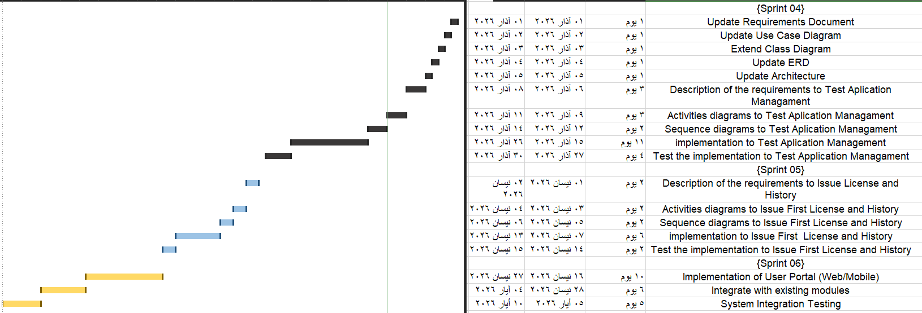
Gantt Chart

Slide 7
Previous Requirement
Req ID | Description | Category | Actor
FR-1 | Add a New Person | Person Management | All Employees
FR-2 | Update Person Data | Person Management | All Employees
FR-3 | Delete Person | Person Management | All Employees
FR-4 | View Person Data | Person Management | All Employees
FR-5 | Searching for a Person | Person Management | All Employees
FR-6 | Delete a Employee | Employee Management | System Admin
FR-7 | Change their Password | Employee Management | System Admin
FR-8 | Create a New Account for Employee | Employee Management | System Admin
FR-9 | View Employee Data | Employee Management | System Admin
FR-10 | Update Employee Data | Employee Management | System Admin
FR-11 | Searching for a Employee | Employee Management | System Admin
FR-12 | Login Accounts for Employees | Employee Management | All Employees
FR-13 | View Current User Info | Employee Management | All Employees
FR-14 | Change Current User's Password | Employee Management | All Employees
FR-15 | Logout | Employee Management | All Employees
FR-16 | View Applications Type Data | Application Management | System Admin
FR-17 | Edit Applications Types | Application Management | System Admin
FR-18 | View Application Info | Application Management | All Employees
FR-19 | Request a New Local License Application for a Person | Application Management | All Employees
FR-20 | Delete Local License Application | Application Management | All Employees
FR-21 | Cancel Local License Application | Application Management | All Employees
FR-22 | Edit Local License Application | Application Management | All Employees
FR-23 | Searching for a Request | Application Management | All Employees
NFR-1 | The System Should have User-Friendly Interface | Non Functional | -
NFR-2 | The System Should Store Data Securely Using Encryption | Non Functional | -

Slide 8
New Requirement
FR-24 | the System Should Allow Admin to View Test Type Data | Test Management | Admin
FR-25 | the System should Allow Admin to Edit Test Types | Test Management | Admin
FR-26 | the System Should Allow Test officer to Schedule Vision Test | Test Management | Test officer
FR-27 | the System should allow test officer to Edit the appointment for vision test | Test Management | Test officer
FR-28 | the system should allow test officder to put result of vision test | Test Management | Test officer
FR-29 | the System Should Allow Test officer to Schedule written Test | Test Management | Test officer
FR-30 | the System should allow test officer to Edit the appointment for written test test | Test Management | Test officer
FR-31 | the system should allow test officer to put result of written test | Test Management | Test officer
FR-32 | the system should allow test officer to schedule street test | Test Management | Test officer
FR-33 | the system should allow test officer to edit the appointment for street test | Test Management | Test officer
FR-34 | the system should allow test officer to put result of street test | Test Management | Test officer
FR-35 | the system should allow license officer to create First Time license for person | license Management | license officer
FR-36 | the system should allow license officer to view license information | license Management | license officer
FR-37 | the system should allow citizen to Create Application for local license | citizen management | Citizen
FR-38 | the system should allow citizen to view his Application info | citizen management | Citizen

Slide 9
Product Backlog
01- As a license officer, I want to add a new person so that I can register their information in the system.
02- As a license officer, I want to edit an existing person’s information so that I can correct or update their data.
03- As a license officer, I want to view a person’s information so that I can verify their details.
04- As a license officer, I want to delete a person so that I can remove unnecessary records.
05- As a license officer, I want to filter people by name or national No ........ so that I can quickly find the required person.
06- As an admin, I want to create an account for a new employee so that they can access the system.
07- As an admin, I want to update employee information so that I can ensure their records remain accurate and current.
08- As an admin, I want to view employee information so that I can verify their details.
09- As a manager, I want to delete an employee so that I can ensure system security and prevent unauthorized access after they leave.
10- As an admin, I want to filter employees so that I can quickly find the required employee

Slide 10
11- As an admin, I want to change employee’s password so that I can keep their account secure.
12- As a system user, I want to log in so that I can access the system.
13- As a system user, I want to view my account information so that I can verify my personal details.
14- As a system user, I want to change my password from my account page so that I can maintain security.
15- As a system user, I want to log out so that I can end my current session.
16- As an admin, I want to manage application types so that I can efficiently monitor categories and quickly update their details to keep the system running smoothly.
17- As a license officer, I want to view application information so that I can verify details.
18- As a license officer, I want to submit a local driving license request for a person so that they can obtain a local license.
19- As a license officer, I want to delete a local license application so that I can remove unnecessary requests.
20- As a license officer, I want to cancel a local license application so that I can stop the process if no longer needed.

Slide 11
21- As a license officer, I want to edit a local license application so that I can change the license class of this application.
22- As an employee, I want to filter applications by person’s name or status ..... so that I can quickly find the required application.
23 – as an admin, I want to manage test types so that the system maintains accurate and up-to-date information about available tests.
24 - as a test officer, I want to manage vision, written, and street tests so that applicants can complete the required examinations and their results are properly recorded
25- as a license officer, I want to create a first-time driving license for a person so that qualified applicants can legally drive
26- as a license officer, I want to view license information so that I can verify license details when needed
27- as a citizen, I want to create an application for a local license so that I can start the licensing process
28- as a citizen, I want to view my application information so that I can track the progress and details of my application.

Slide 12
Sprint {4} Backlog
1- as an admin, I want to view test type data so that I can review and monitor the available types of driving tests in the system.
Acceptance Criteria:
- system displays a list of all test types. - Each test type shows test name and description. - just Admin can open a test type to view its details.
2- as an admin, I want to update test type information so that the system maintains accurate and up-to-date test definitions.
Acceptance Criteria:
- Input fields: Test name, description , price. - Test name must not be empty. - Success message appears after updating the test type.

Slide 13
3- as a test officer, I want to schedule a vision test for an applicant so that the applicant can complete the required vision examination.
Acceptance Criteria:
- applicant must have a valid application. - System saves the vision test appointment. - Success message appears after scheduling the test.
4- as a test officer, I want to modify the appointment of a vision test so that scheduling conflicts or changes can be handled properly.
Acceptance Criteria:
- System allows editing an existing vision test appointment.
- New date should be greater than old date - Updated information is saved successfully. - Success message appears after updating the appointment.
5- as a test officer, I want to record the result of a vision test so that the system can determine whether the applicant passed the vision requirement.
Acceptance Criteria:
Input fields: Test result (Pass / Fail). Vision test must already be scheduled. System saves the test result successfully.

Slide 14
6- as a test officer, I want to schedule a written test for an applicant so that the applicant can complete the theoretical driving examination.
Acceptance Criteria:
- Applicant must have a valid application. - Applicant must pass the vision test first. - Success message appears after scheduling the test
7- as a test officer, I want to update the appointment of a written test so that changes in the testing schedule can be managed efficiently.
Acceptance Criteria:
- System allows editing an existing written test appointment.
- New date should be greater than old date - Updated information is saved successfully. - Success message appears after updating the appointment
8- as a test officer, I want to record the result of a written test so that the system can determine whether the applicant passed the theoretical exam.
Acceptance Criteria:
- Input fields: Test result (Pass / Fail). - Written test must already be scheduled. - System records the test result successfully.

Slide 15
9- as a test officer, I want to schedule a street test so that the applicant can complete the practical driving examination
Acceptance Criteria:
Applicant must have passed the required previous tests. System saves the street test appointment. Success message appears after scheduling the test
10- as a test officer, I want to modify the appointment of a street test so that I can adjust the driving test schedule when necessary.
Acceptance Criteria:
Updated information is saved successfully. Success message appears after updating the appointment
New date should be greater than old date
11- as a test officer, I want to record the result of a street test so that the system can determine whether the applicant passed the practical driving exam.
Acceptance Criteria:
- Input fields: Test result (Pass / Fail). - Street test must already be scheduled. - System records the test result successfully

Slide 16
Sprint {5} Backlog
1- as a license officer, I want to create a first-time driving license for a person so that qualified applicants can legally drive.
Acceptance Criteria:
Input fields: Person ID , issue date, expiry date….. Person must have passed all required tests. Success message appears after license creation.
2- as a license officer, I want to view license information so that I can verify license details when needed.
Acceptance Criteria:
- System displays license information. - Displayed information includes license number, person name, issue date, expiry date, and license status

Slide 17
Sprint {6} Backlog
1- as a citizen, I want to create an application for a local driving license so that I can start the license application process.
Acceptance Criteria:
- All required fields must be completed. - System generates a unique application number. - Success message appears after submitting the application.
4- as a citizen, I want to view my application information so that I can track the progress and details of my application.
Acceptance Criteria:
- System displays application details. - Displayed information includes application status, application date, related test appointments and
personal Information.

Slide 18
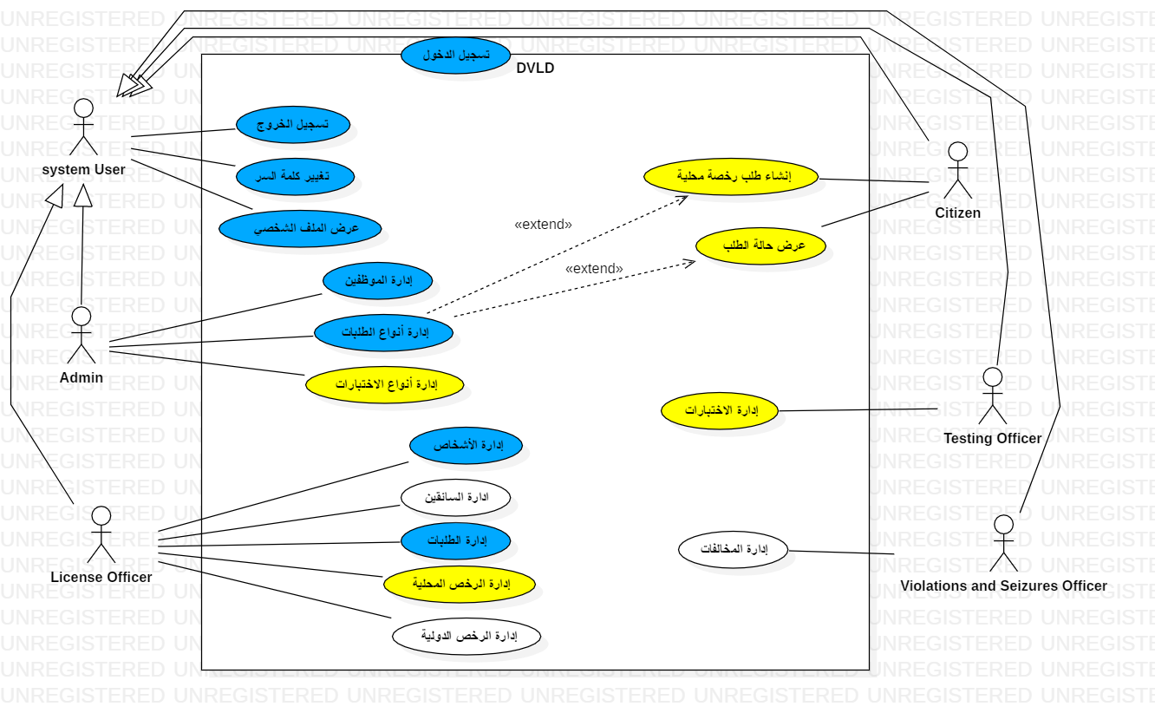
Use Case High Level

Slide 19
Requirement Description Table
Use Case Title | Test Management
Actors | Employee
Prerequisites | Login
Main flow | 1. The test administrator clicks the Manage Requests icon. 2. The system displays the Requests interface. 3. The test administrator clicks the Tests icon. 4. The system displays the Tests interface and shows the person's previous appointments for the selected test, if any. 5. If the test administrator chooses to add a new appointment: I. The system displays the Add Appointment interface. II. The test administrator selects the test date and clicks the Save button. III. The system displays a success message. 6. If the test administrator chooses to modify an appointment: I. The system displays the Modify Appointment interface. II. The test administrator modifies the test date and clicks the Save button. III. The system displays a success message. 7. If the test administrator chooses to set the test result: I. The system displays the Set Test Result interface. II. The test administrator sets the person's result (Pass or Fail) and clicks the Save button. III. The system displays a success message.
alternative flow | At step 5: 1- If the person has passed the specified test or has an active appointment, the system displays a rejection message.
Exit condition | Not Found

Slide 20
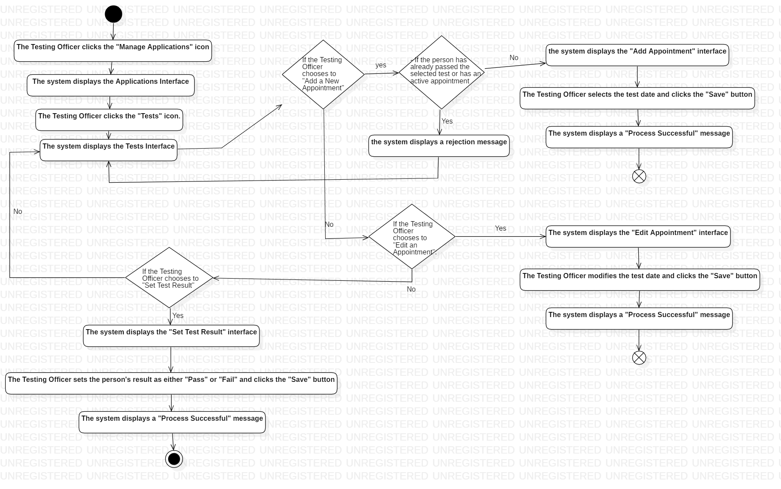
Activity diagram

Slide 21
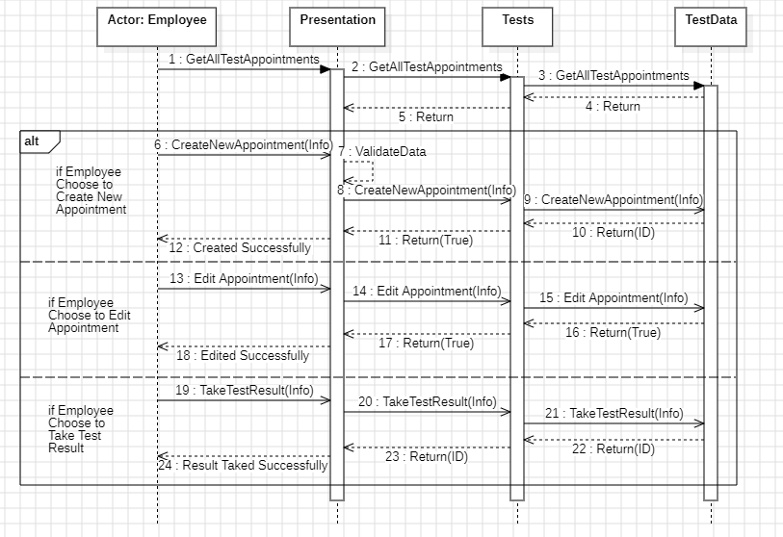
Sequence diagram

Slide 22
Test Case
ID | TC_26
address | Changing a test appointment for a person
Test steps | 1. Open the exam management interface 2. Open the appointment modification interface 3. Select the new appointment date 4. Click the save button
Expected result | The message "Process Success" appears
ID | TC_18
address | Create a local license and select a category for a person who has an active application for the same category.
Test steps | 1. Open the local license creation interface 2. Fill in the required information 3. Click the save button
Expected result | A message appears saying, "You cannot place an order because the person already has an active order."
ID | TC_25
address | Book a test appointment for someone who has passed the test
Test steps | 1. Open the exam management interface. 2. Click the Add Dates button. 3. Click the Save button.
Expected result | The message "Process failed" appears because the person passed this type of test.

Slide 23
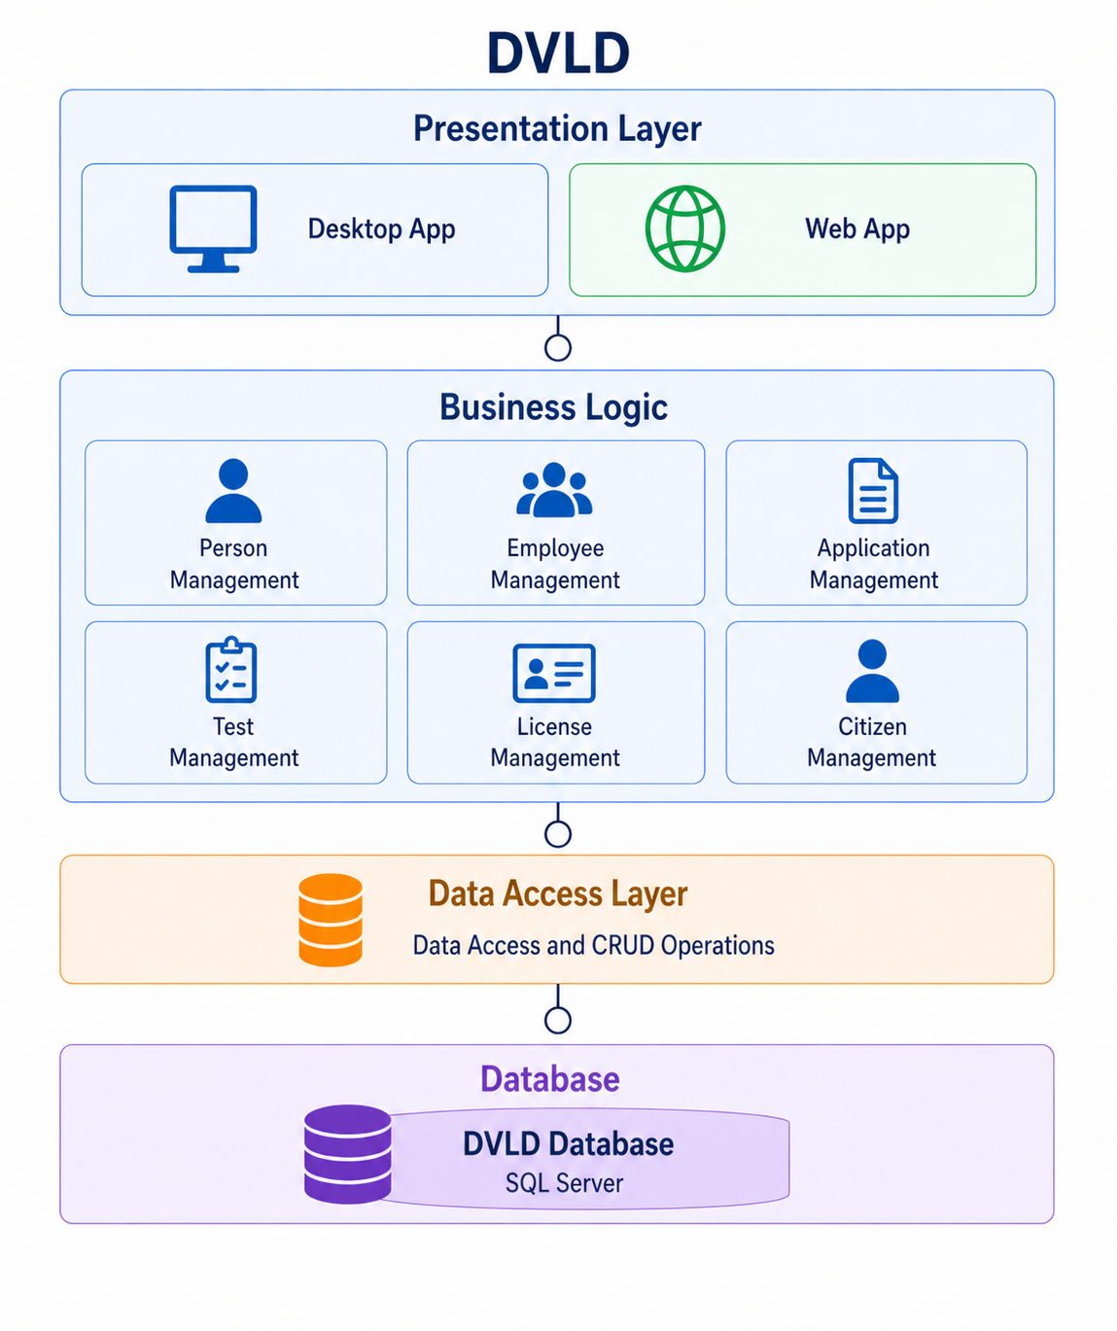
System Architecture

Slide 24
RTM
req-id | Use cases | analysis | System design | Detailed design | coding | Test cases
RE-FR-EM-25 | UC_01 | EM-EN | AM-DL-01 |  | sours | TC_26
RE-FR-EM-26 | UC_01 | EM-EN | AM-DL-01 |  | sours | TC_24

Slide 25
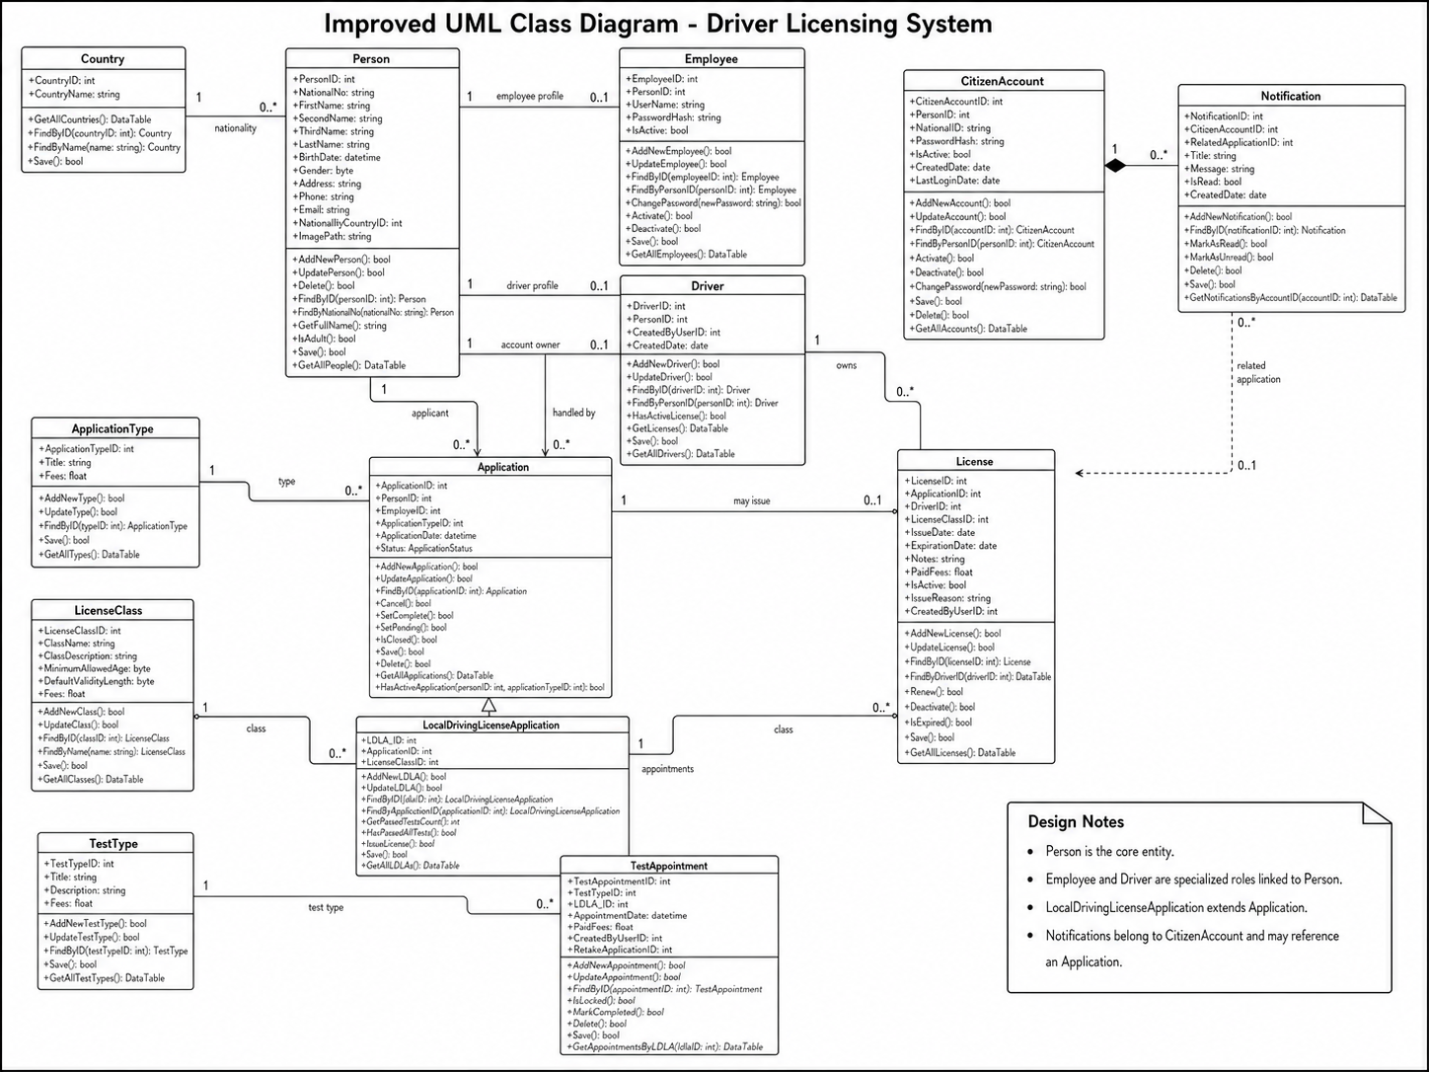
Class Diagram

Slide 26
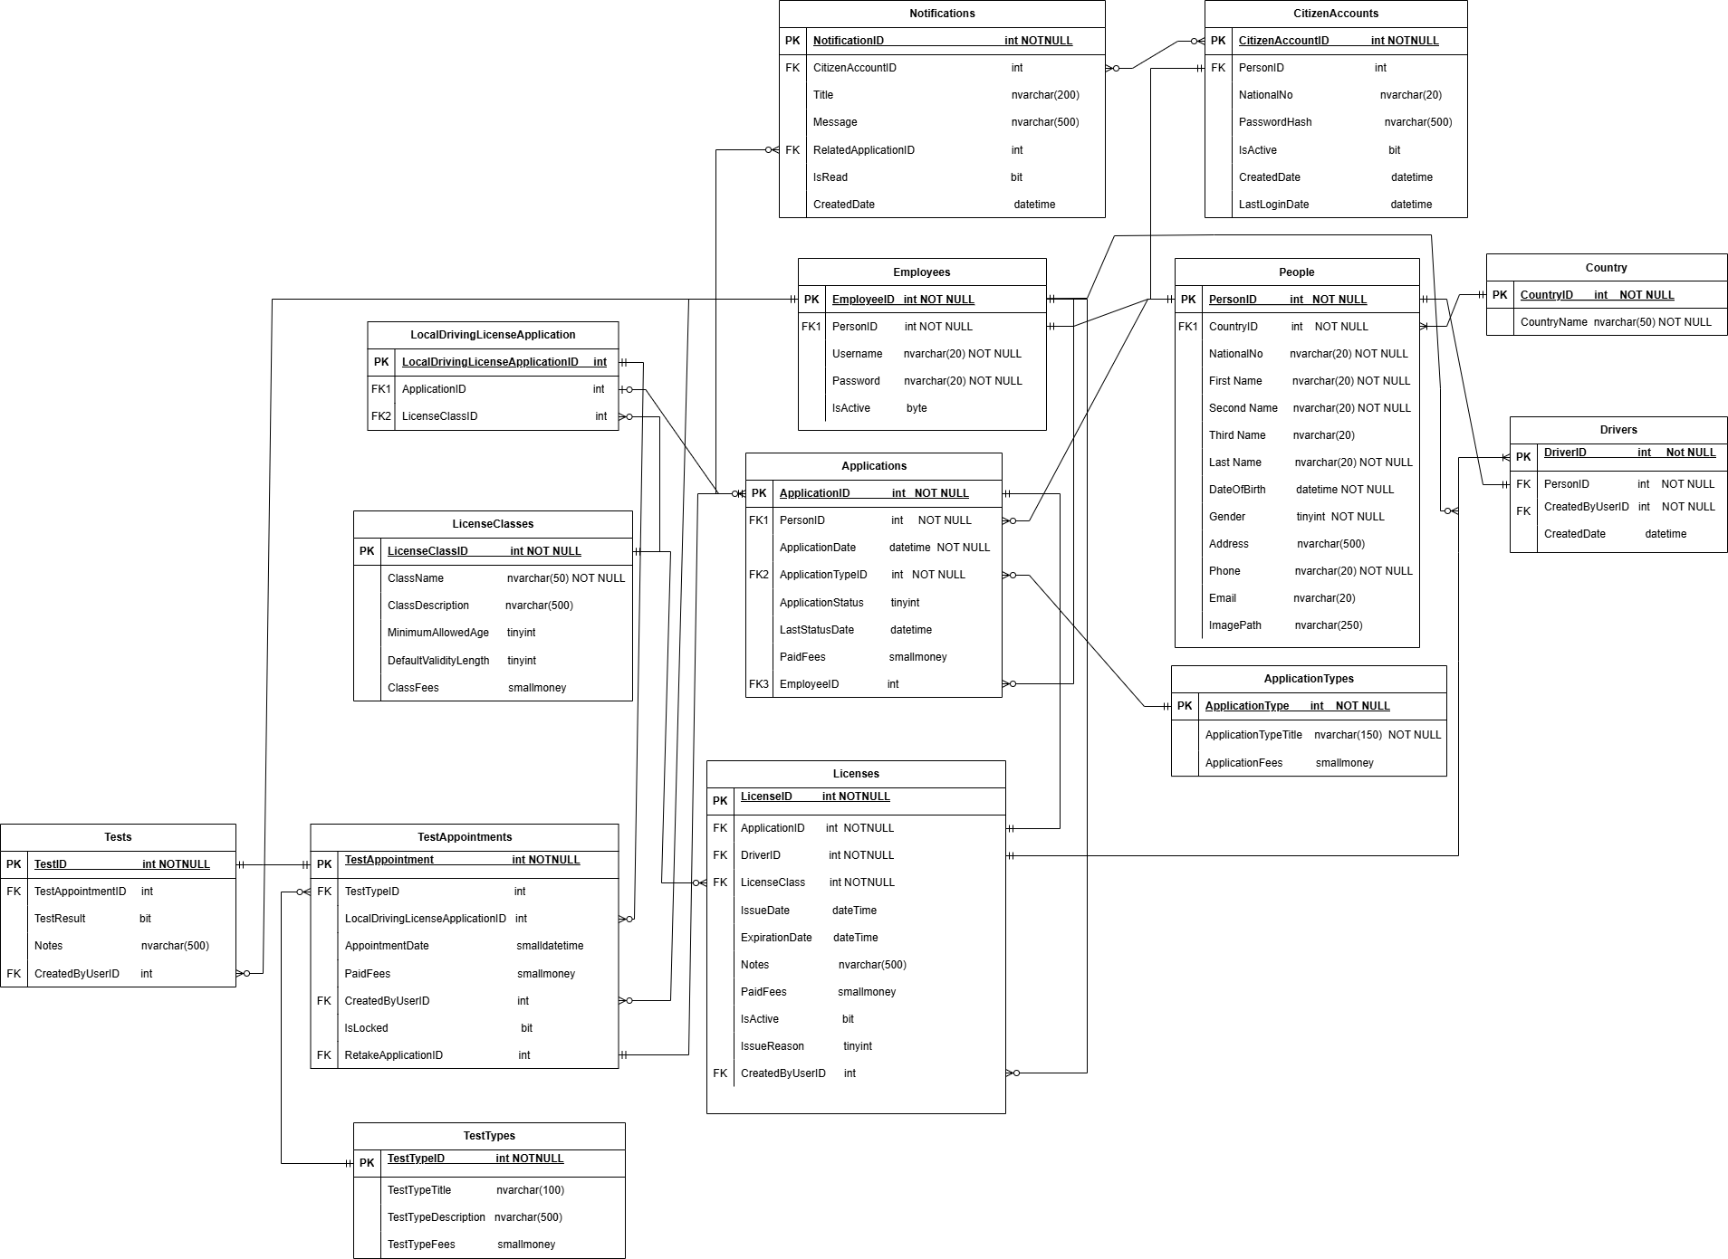
Erd Schema

Slide 27
Used Tools
Application Type: Desktop Application (for Employees)
Web Portal (for Citizens)
Programming Language: C#
Desktop UI Framework: Windows Forms
Web Frontend : HTML, CSS, JavaScript, Razor, Bootstrap
Web Framework / Backend : ASP.NET Core
Development Environment: Visual Studio
Database: SQL Server
Supporting Libraries: Entity Framework / Entity Framework Cor Bootstrap (for Web UI)

